Slide 1
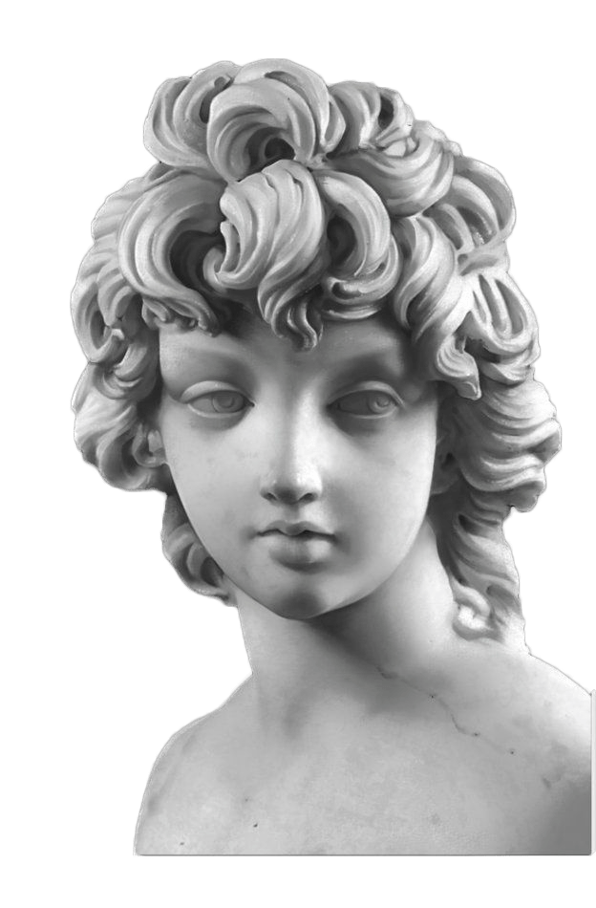
Unit 3
Sports and Fitness
Reading & Thinking
Living Legends

Slide 2
Teaching aims
/ To get basic information about Lang Ping and Jordan and understand why they can be called sports legends.
/To understand the meaning of some languages in the context of the text, such as "time seems to stand still, graceful" and so on.
/Master the reading skill: making predictions.
/Take the initiative to learn the spirit of athletes

Slide 3
01
To learn to use different reading strategies such as skimming, scanning and summarizing.
Teaching Important &
Difficult Points
02
To talk about your living legends.

Slide 4
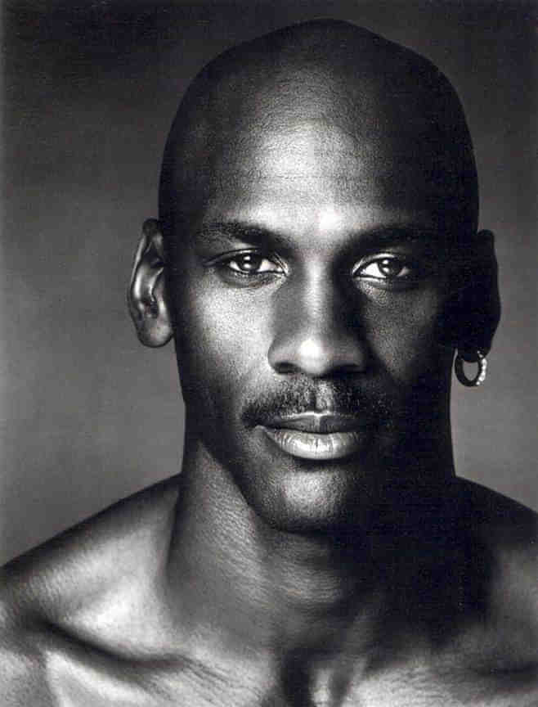
Free Talk
Who is your favorite sports player? Why?

Slide 5
Pre-reading
Read the lead paragraph together and try to understand the purpose of the article.

Slide 6
While-reading
Getting detailed information about Lang Ping and Michael Jordan.
Lang Ping: Sum up the information with the table
Living legends | Masters | Good examples
Lang Ping | As a
 | As a
 | As a

Slide 7
While-reading
Getting detailed information about Lang Ping and Michael Jordan.
Lang Ping: Sum up the information with the table
Living legends | Masters | Good examples
Lang Ping | As a player | Bring honor and glory to her country
 | As a coach | Lead the china volleyball team to medals at world championships and the Olympics
 | As a person | Be loved by fans at home and abroad

Slide 8
While-reading
Getting detailed information about Lang Ping and Michael Jordan.
Michael Jordan: please read the text about Michael Jordan and discuss the following multiple choices.
1.What does the first sentence in the paragraph introducing Michael Jordan mean?
A．Jordan's determination in basketball field.
B．Jordan's success in basketball field.
C．Jordan's handsome figure (身材)．
D．Jordan's quick movement in playing basketball.

Slide 9
While-reading
Getting detailed information about Lang Ping and Michael Jordan.
Michael Jordan: please read the text about Michael Jordan and discuss the following multiple choices.
2. The following about Jordan is right except ________.
A．He accepts failures
B．He can’t accept not trying
C．He believes that the secret to success is learning from failures
D．He doesn't like to share his success with others

Slide 10
Discussion
Please work in four people-group and try to answer the following questions.
1-What does “living legend” mean?
2-What are the standards（标准） or requirements（要求） to be chosen as a living legend of sports star?
*masters in their sports
*set good examples for others

Slide 11
语法填空
In the field of sports, there are some famous living 1._____ (legend), such as Lang Ping, Michael Jordan.
As a player, Lang Ping brought not only honor but also glory to her country. As 2.____ coach, she led the China women's volleyball team to medals at world championship as well as the Olympic Games. As a person, she 3._____ (love) by fans at home and abroad. Before the 2015 World Cup, she faced a great challenge. That was 4._____one of the best players had 5.______(injure) and the team captain had to leave because of heart problems. However, Lang Ping didn't lose heart and she led her volleyball team 6._____(win) the championship.

Slide 12
Known as “Air Jordan”， Jordan changed basketball with his graceful moves and jumps. Jordan's skills were 7._______ (impress), but the mental strength made him unique. The secret 8.to his success is learning from his 9._____ (fail). In life, Jordan has learnt to share his success with others. The Boys and Girls Club started in Chicago 10.has______(help) young people since 1996.

Slide 13
01
Discussing
& recommending
*Brainstorm
02
1.think of several adjectives to describe your idol athlete
2.list some representative achievements of the athlete

