Slide 1
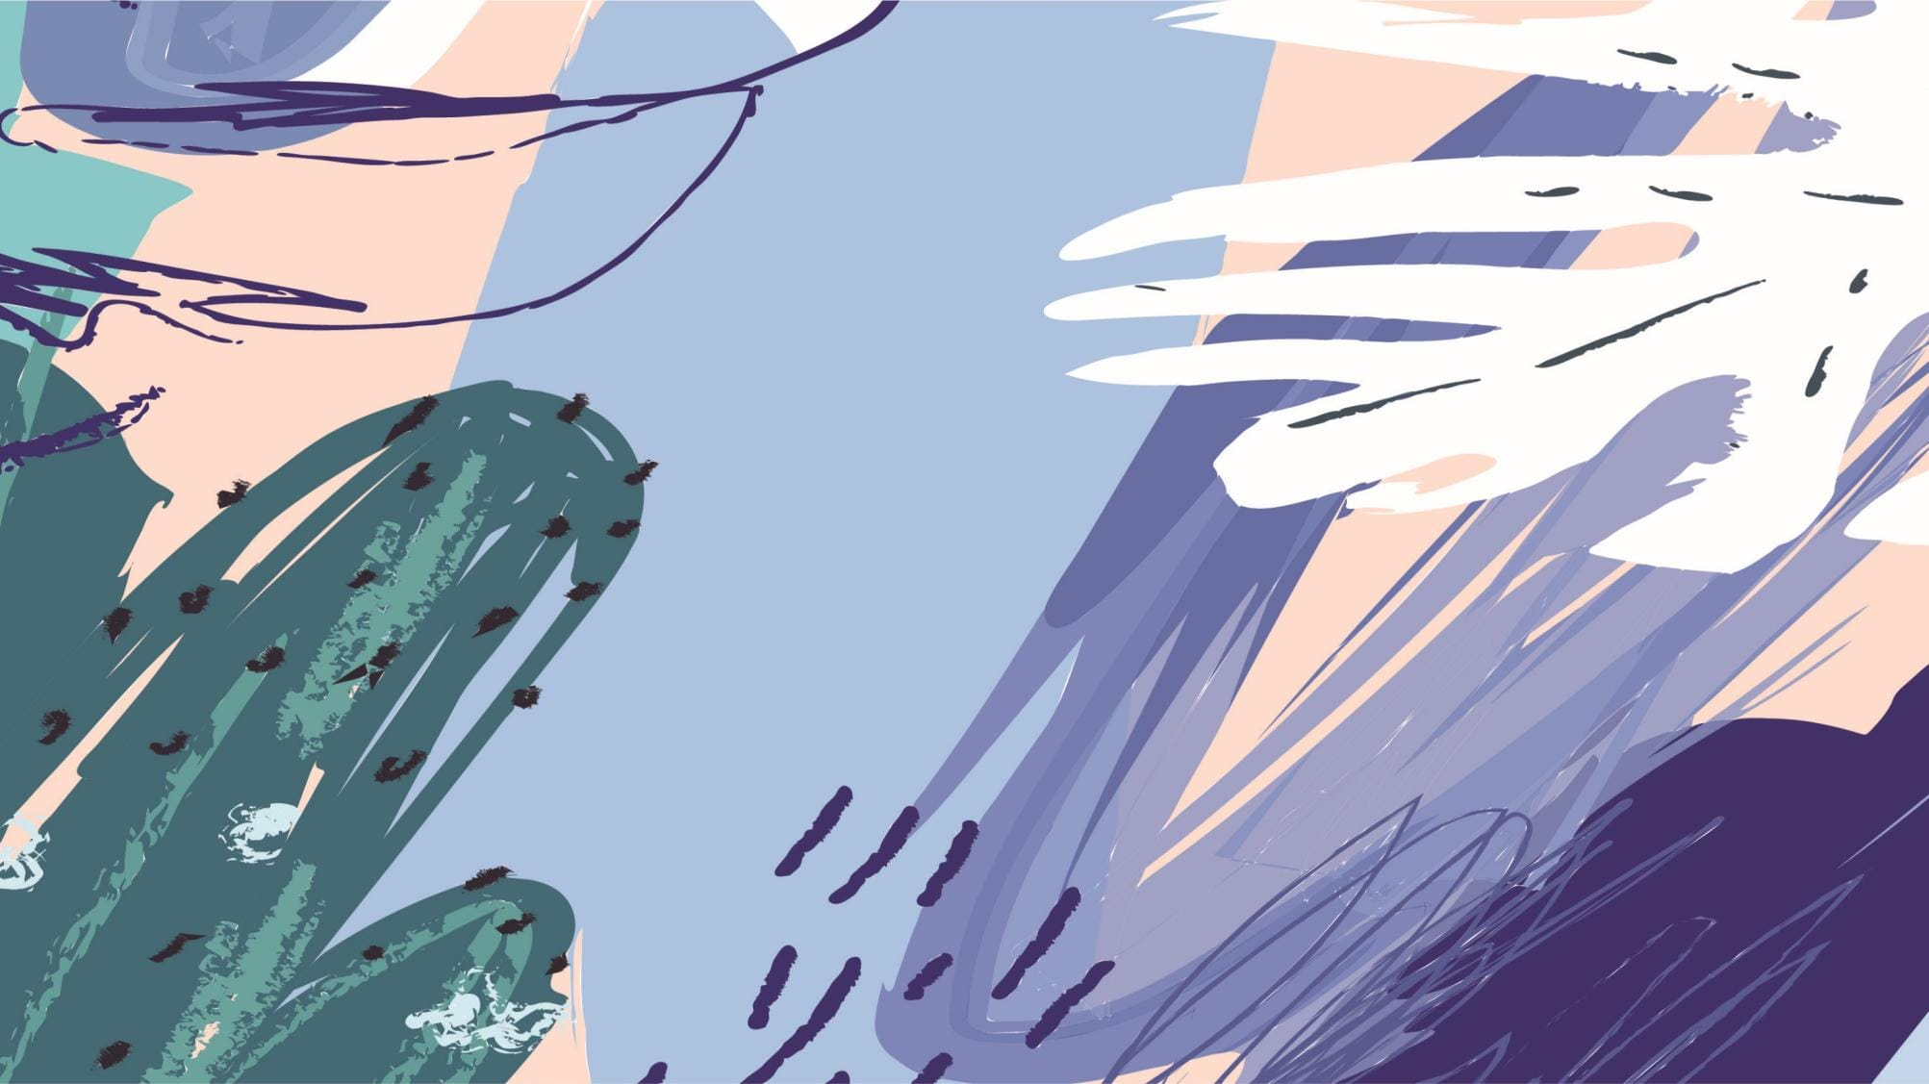
未经原作者允许不得转载本PPT，否则将视为侵权
Unit 3
Could you please tell me where the restrooms are?

Slide 2
未经原作者允许不得转载本PPT，否则将视为侵权
Section A - Reading - Language points
Objective clauses with wh-questions
上一个单元我们已经学习了由that和whether, if引导的宾语从句。这个单元我们继续学习由疑问词引导的宾语从句。
疑问词：疑问代词(what、whom、who、whose、which)疑问副词(when、where、why、how)。

Slide 3
Section A - Reading - Language points
语序
无论主句是陈述句还是疑问句, 也无论主从句间是什么引导词, 宾语从句一律用陈述语序, 即“引导词 + 主语 + 谓语 + 其他”。如：
Could you tell me where Wei Fang lives?

Slide 4
Section A - Reading - Language points
时态
1. 如果主句是一般现在时或一般将来时, 宾语从句的时态不受限制, 可根据实际表达的需要来确定。如：
Jenny knows the man was flying a kite at that time.
You will understand why I did it one day.

Slide 5
未经原作者允许不得转载本PPT，否则将视为侵权
Section A - Reading - Language points
2. 如果主句是一般过去时, 宾语从句用过去时态的某种形式。如：
I thought he had gone to town that day.
我以为他那天进城去了。

Slide 6
Section A - Reading - Language points
3. 如果宾语从句叙述的是客观事实、自然现象或科学真理等，从句不受主句时态的限制，用一般现在时。如：
He said time is money.
他说时间就是金钱。

Slide 7
未经原作者允许不得转载本PPT，否则将视为侵权
Section A - Reading - Language points
D
1. He asked ________ for the computer. A. did I pay how much B. I paid how much C. how much did I pay D. how much I paid 2. “Have you seen the film?” he asked me.
He asked me _______. A. had I seen the film
B. have I seen the film C. if I have seen the film
D. whether I had seen the film
D

Slide 8
Section A - Reading - Language points
3. “You’ve already got well, haven’t
you?” she asked. She asked ______.
A. if I have already got well, hadn’t you B. whether I had already got well C. have I already got well
D. had I already got well.
B

Slide 9
Section A - Reading - Language points
4. He asked, “How are you getting
along?”
He asked _______. A. how am I getting along B. how are you getting along C. how I was getting along D. how was I getting along
C

Slide 10
未经原作者允许不得转载本PPT，否则将视为侵权
Section A - Reading - Language points
5. He asked me _____ told me the
accident. A. whom B. which C. who D. whose
6. She asked me if I knew ______. A. whose pen is it
B. whose pen it was C. whose pen it is
D. whose pen was it
C
B

Slide 11
Section A - Grammar Focus
Function
Ask for information politely
and follow directions

Slide 12
Section A - Grammar Focus
问路时应注意：
1. 问路时应首先说一声：“Excuse me.”这样 可以引起对方的注意，又不失礼貌。
2. 当你没听清时，你可以说一声“Excuse me,
would you please say it again?”(对不起，请您再说一遍好吗?) 或“I beg your pardon?” (对不起，请再说一遍好吗?)等，礼貌地要求 对方重复一遍。

Slide 13
Section A - Grammar Focus
3. 问完路后，千万不要忘记向对方说句
“Thank you for helping me.” 或“Thank you.”
4. 问路时经常会用到“向左(右)拐”这样的表达，英语对此有两种常见的说法，即turn left (right)或turn to the left (right)。表示“在左(右)边”，英语用介词on或at均可。

Slide 14
Section A - Grammar Focus
用英语问路及其回答：
1. Excuse me, can you tell me where the railway station is?
打扰一下，请问火车站在哪儿?
2. Excuse me, but can you tell me the way to the train station?
劳驾，请问去火车站怎么走?
3. Excuse me, could you tell me which is the way to the nearest hospital?
劳驾，请问去最近的医院怎么走?
4. Excuse me, would you please show me the way to the post office?
请告诉我去邮局怎么走好吗?

Slide 15
Section A - Grammar Focus
5. Excuse me, would you mind telling me the way to the police station?
劳驾，请告诉我去警察局怎么走好吗？
6. Excuse me, how can I get to No. 1 Middle School?
劳驾，请问去一中怎么走?
7. Excuse me, is this the right way to the People’s Park?
打扰了，请问去人民公园走这条路对吗?

Slide 16
Section A - Grammar Focus
8. Excuse me. Could you tell me if there is a
Wangmin Middle School near here?
打扰了，请问王民中学是否在这附近？
9. Excuse me. Do you know how I can get to
Wangmin Middle School?
= Excuse me. Do you know how to get to
Wangmin Middle School?
请问，你知道怎样去王民中学吗?

Slide 17
Section A - Grammar Focus
指路的方式
1. Take along with this street, and … is on your left.
2. Go down this way, and turn left at the
first crossing, and you’ll find … is
right there, on your left.

Slide 18
Section A - Grammar Focus
3. … is behind (near, next to, on the left of) …
4. You can just take No. 111 bus, and get
off at the second station. And you’ll see it.
5. Look! … is in front of us far away, right there!

Slide 19
Section A - Grammar Focus
4a Rewrite the questions to make them more polite.
1. Where can I buy some grapes or other fruit?
2. How does this CD player work?
3. How do I get to the Central Library?
4. Is the Italian restaurant nearby open on Mondays?

Slide 20
未经原作者允许不得转载本PPT，否则将视为侵权
Section A - Grammar Focus
1. Could you please tell me where I can buy some grapes or other fruit?
2. Excuse me, do you know how this CD player works?
3. Can you tell me how to get to the
Central Library?
4. I wonder if the Italian restaurant nearby is open on Monday.

Slide 21
Section A - Grammar Focus
4c Write four questions that a tourist might ask about your town/city. Then role-play conversations with your partner.
Excuse me, do you know where I can buy a local phone card?
2. Pardon me, could you tell me where the central bus station is?

Slide 22
Section A - Grammar Focus
3. Could you please tell me where the nearest supermarket is?
4. Excuse me, is there a fast food restaurant nearby?

Slide 23
Section A - Homework
在作业本上完成4b,明天上课前交

Slide 24
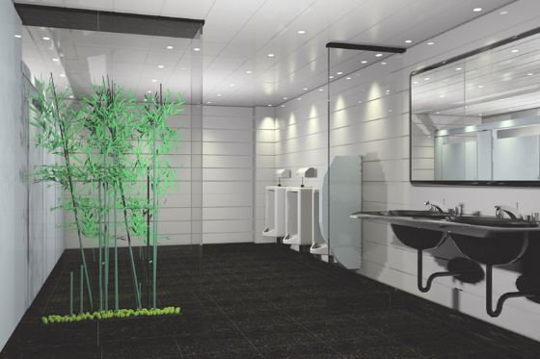
Section B - Warming up
What qualities are important for each place?
clean
restroom

Slide 25
Section B - Warming up
museum
interesting

Slide 26
未经原作者允许不得转载本PPT，否则将视为侵权
Section B - Warming up
restaurant
delicious, inexpensive
adj. 不昂贵的

Slide 27
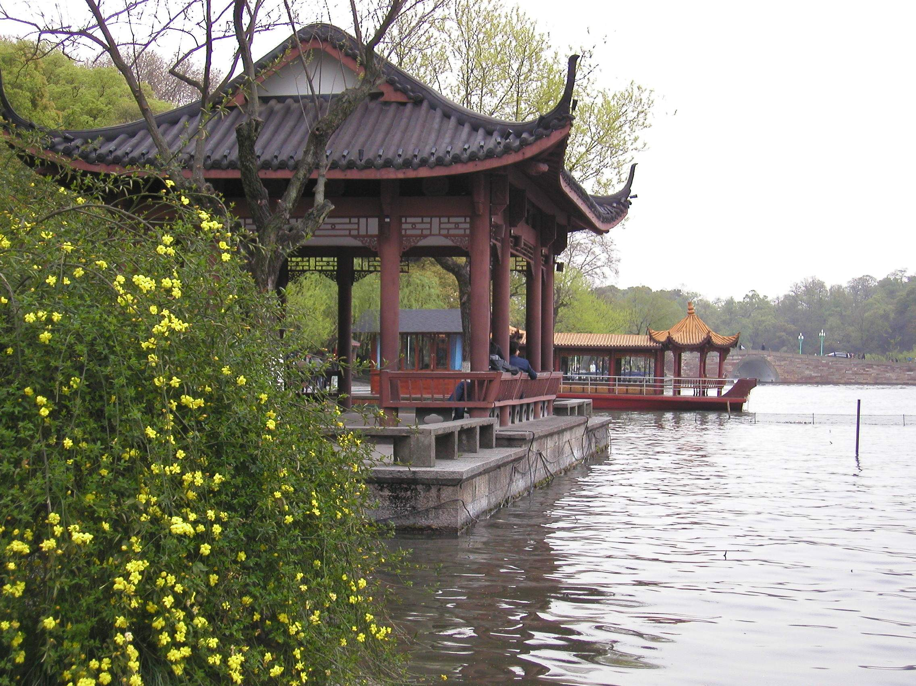
Section B - Warming up
beautiful
fascinating adj.
极有吸引力的
park

Slide 28
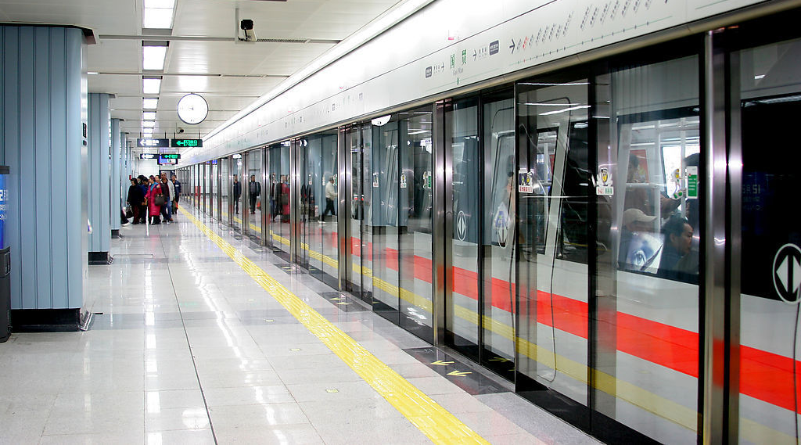
Section B - Warming up
uncrowded
subway
adj. 不拥挤的; 人少的

Slide 29
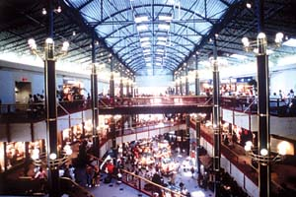
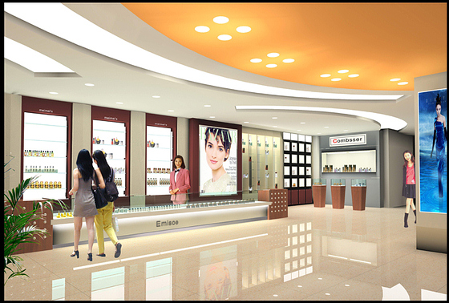
inexpensive
adj. 不昂贵的
safe
big
convenient adj.
便利的, 方便的
mall 商场, 购物中心

Slide 30
未经原作者允许不得转载本PPT，否则将视为侵权
Section B - Warming up - 1a
interesting fascinating inexpensive quiet uncrowded big beautiful convenient safe clean
Places | Qualities
restroom
museum
clean, uncrowded, convenient
interesting, quiet, uncrowded

Slide 31
Section B - Warming up
interesting fascinating inexpensive quiet uncrowded big beautiful convenient safe clean
Places | Qualities
restaurant
park
subway
mall
clean, inexpensive, quiet
beautiful, safe, clean, big
uncrowded, safe, convenient
inexpensive, big, convenient, interesting, safe

Slide 32
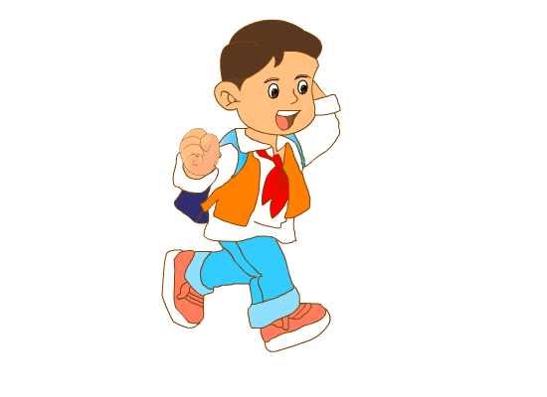
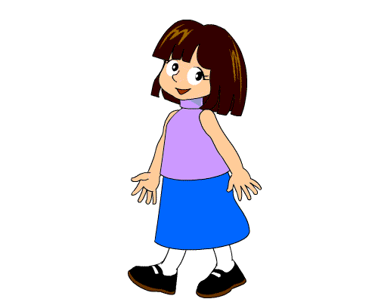
Section B - Warming up
1b Talk about places in your city using the words in 1a.
The Fine Arts Museum is really interesting.
Yes, and it’s beautiful, too.

Slide 33
未经原作者允许不得转载本PPT，否则将视为侵权
Section B - Listening
1c Listen to the conversations and complete the sentences.
Conversation 1
The boy asks about ________________, and the clerk tells him to go to Green Land.
a good restaurant
n. 拐角, 角落
Conversation 2
The girl asks about ______________, and the clerk tells her to go to the corner of Market and Middle Streets.
public restrooms

Slide 34
Section B - Listening
Conversation 3
The mother asks about _____________. The father wants to go to a ________ museum. The younger girl wants to go to a _______ museum. The boy wants to go to a __________ museum. The older girl wants to go to an ______ museum. The clerk suggests they go to the _________ museum.
a good museum
history
science
Children’s
art
computer

