Slide 1
Lesson 11
Unit 3

Slide 2
重点内容
单词复习：
eyes/ears/nose/mouth/face, hand/arm/head/leg/body/foot
句型复习：
This is the _____.
Spelling拼写书写：Ee, Ff, Gg, Hh, Ii

Slide 3
Review

Slide 4
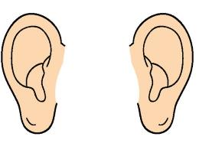
eyes
ears
nose
mouth
face

Slide 5
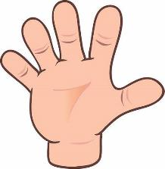
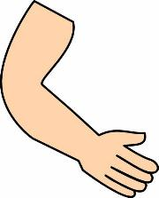
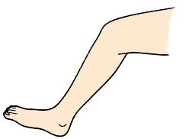
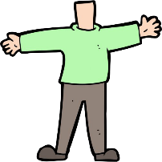
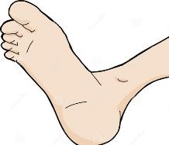
arm
head
hand
leg
body
foot

Slide 6
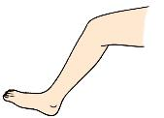
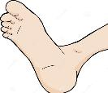
Let's say

Slide 7
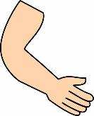
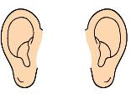
Let's say

Slide 8
This is the ___ .

Slide 9
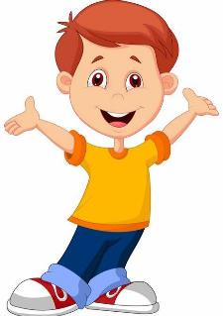
How are you?
I’m fine, thank you.

Slide 10
Let’s talk

Slide 11
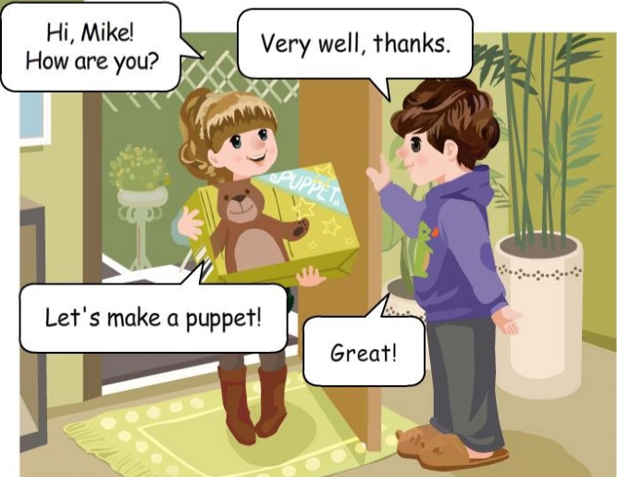

Slide 12
Very well, thanks.
How are you?

Slide 13
Let’s ___________.
go to school

Slide 14
Let’s _____________.
make a puppet

Slide 15
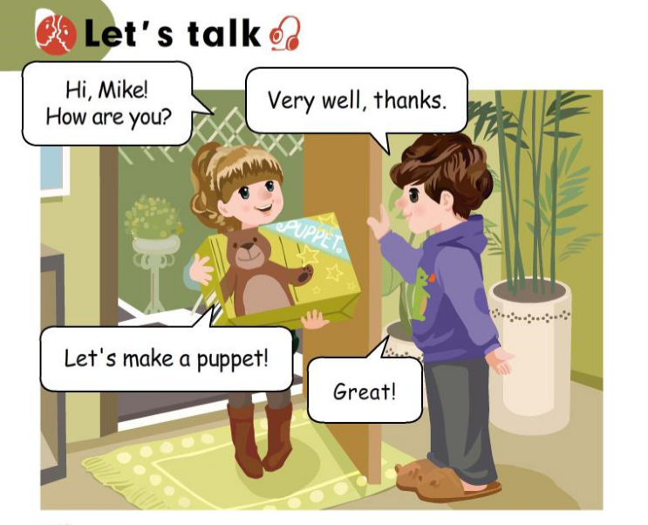

Slide 16
Let’s spell

Slide 17
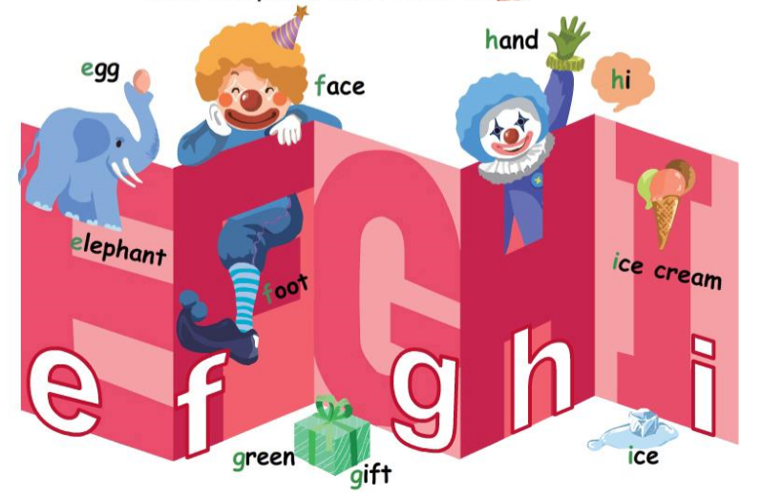

Slide 18
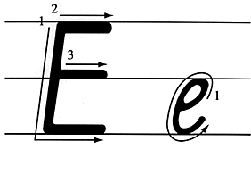
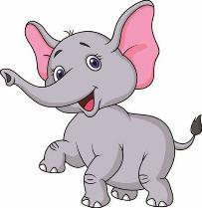
elephant
egg

Slide 19
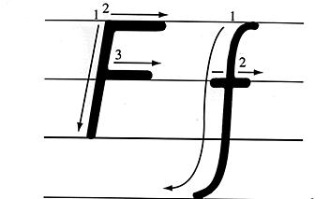
face
foot

Slide 20
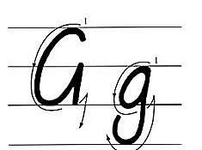
green
gift

Slide 21
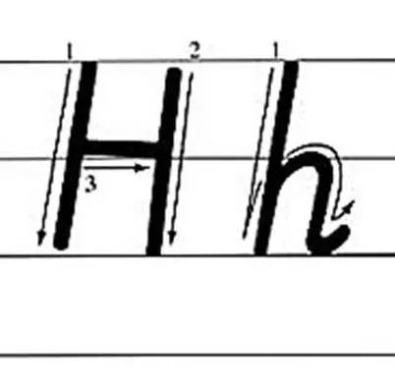
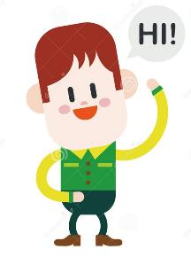
hand
hi

Slide 22
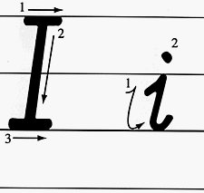
ice
ice cream

Slide 23
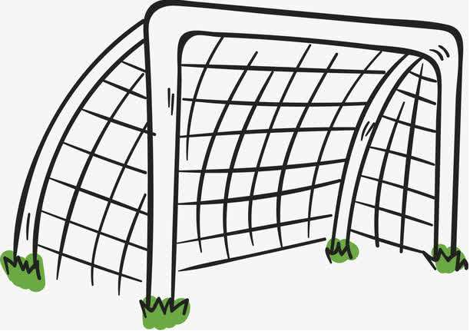
Ii
Ff
Gg
Hh
Ee
Ff
Gg
Ee
Ii
Hh
10
9
8
7
1
2
6
3
4
5

Slide 24
Practice

Slide 25
三、圈出图片所代表的单词的首字母大小写。
A I E
E F D
C G D
e a i
e a i
g f h

Slide 26
三、圈出图片所代表的单词的首字母大小写。
H C A
F D A
i h b
g f e

Slide 27
重点内容
重点单词：
eye ear mouth face
hand head arm body leg foot重点句型：
(1) This is the _____. (This is the leg.)
(2) Let’s _____. (Let’s make a puppet.)
(3) - How are you? - Very well, thanks.
2. Let's talk B

Slide 28
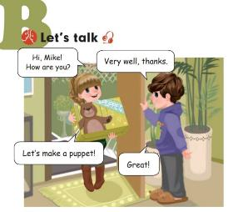
Homework:
抄写单词，3英1汉，并背诵默写
eye眼睛 ear耳朵 mouth嘴巴 face脸 nose
2.角色扮演Let‘s talk B内容，视频打卡

