Slide 1
Unit 5 What were you doing when
the rainstorm came?
Section A 1a-1c

Slide 2


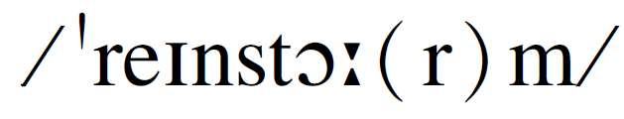
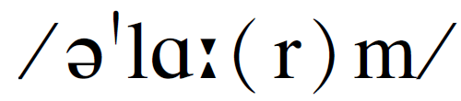
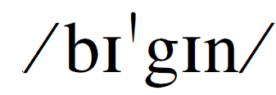
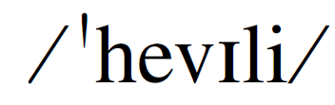
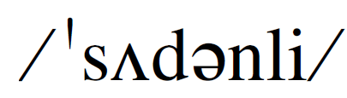
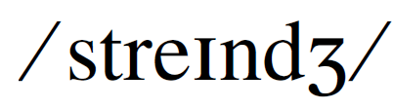
Words
n. 暴风雨
n. 闹钟
v. 开始
adv. 在很大程度上；大量地
adv. 突然；忽然
adj. 奇特的；奇怪的
rainstorm
alarm
begin (began)
heavily
suddenly
strange

Slide 3
Game
&
Competition

Slide 4
Acting & Guess
What is he / she doing now?

Slide 5
Lead-in
How's the weather?

Slide 6

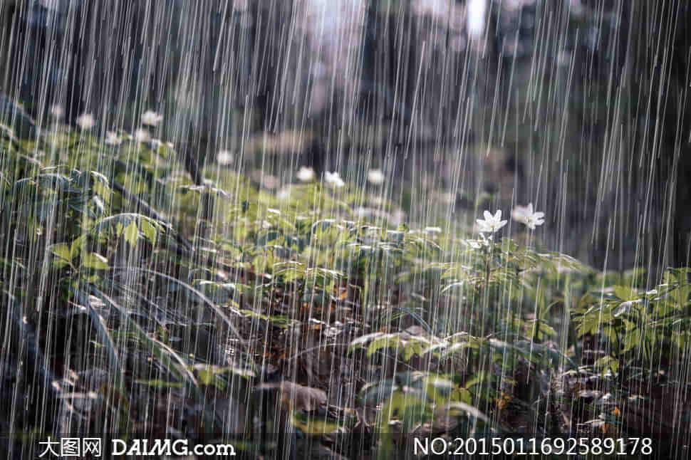
Lead-in
How's the weather?
thunderstorm rainstorm

Slide 7
Comparison
What were you doing
when the rainstorm came?
What are you doing now?
What were you doing
at the time of the rainstorm?
在……的时候

Slide 8
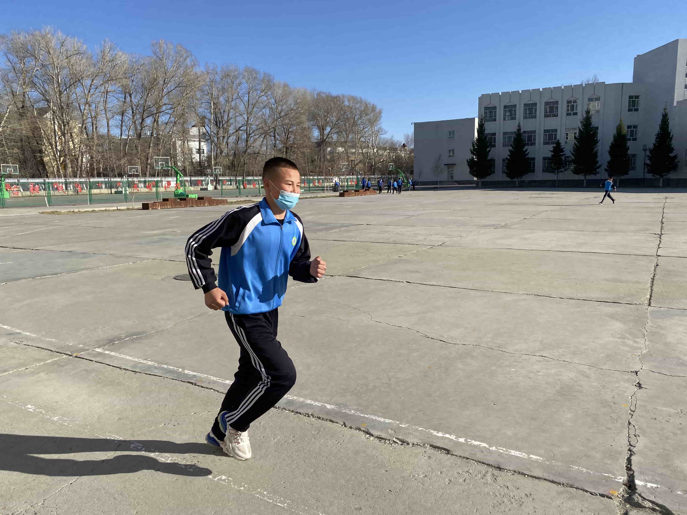
What is he doing now ?
He is running .
What was he doing when the rainstorm came?
He
was running .
Notes:
*

Slide 9
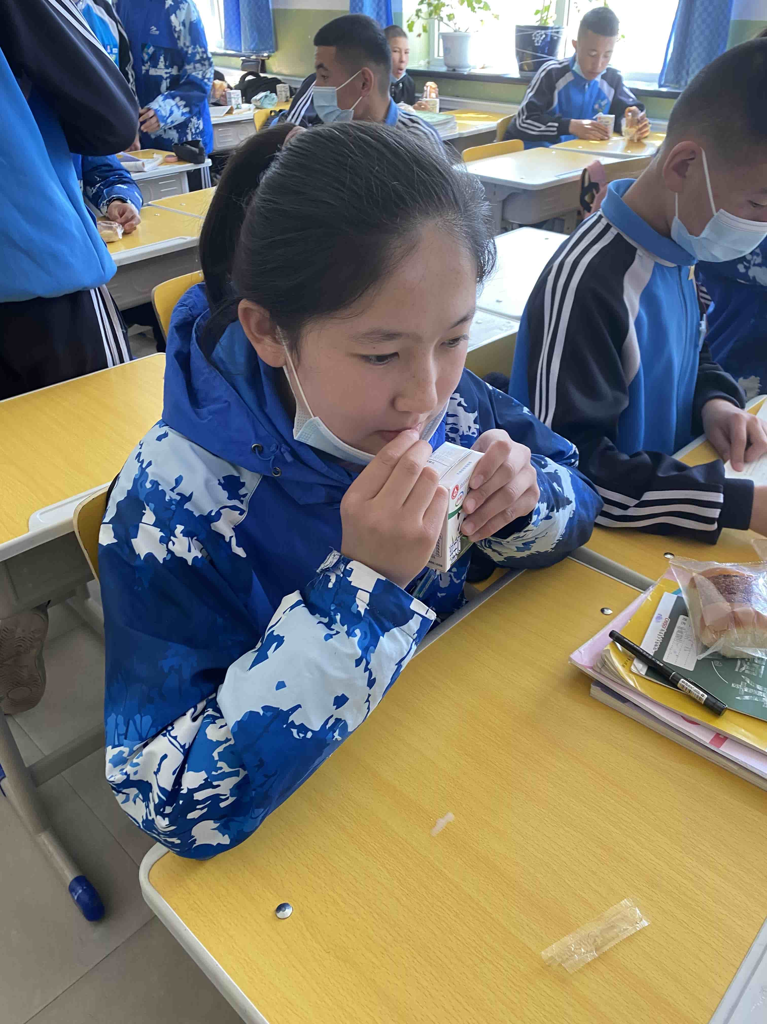
What is she doing now ?
She is drinking milk .
What was she doing when the rainstorm came?
She
was drinking milk .
Notes:
*

Slide 10
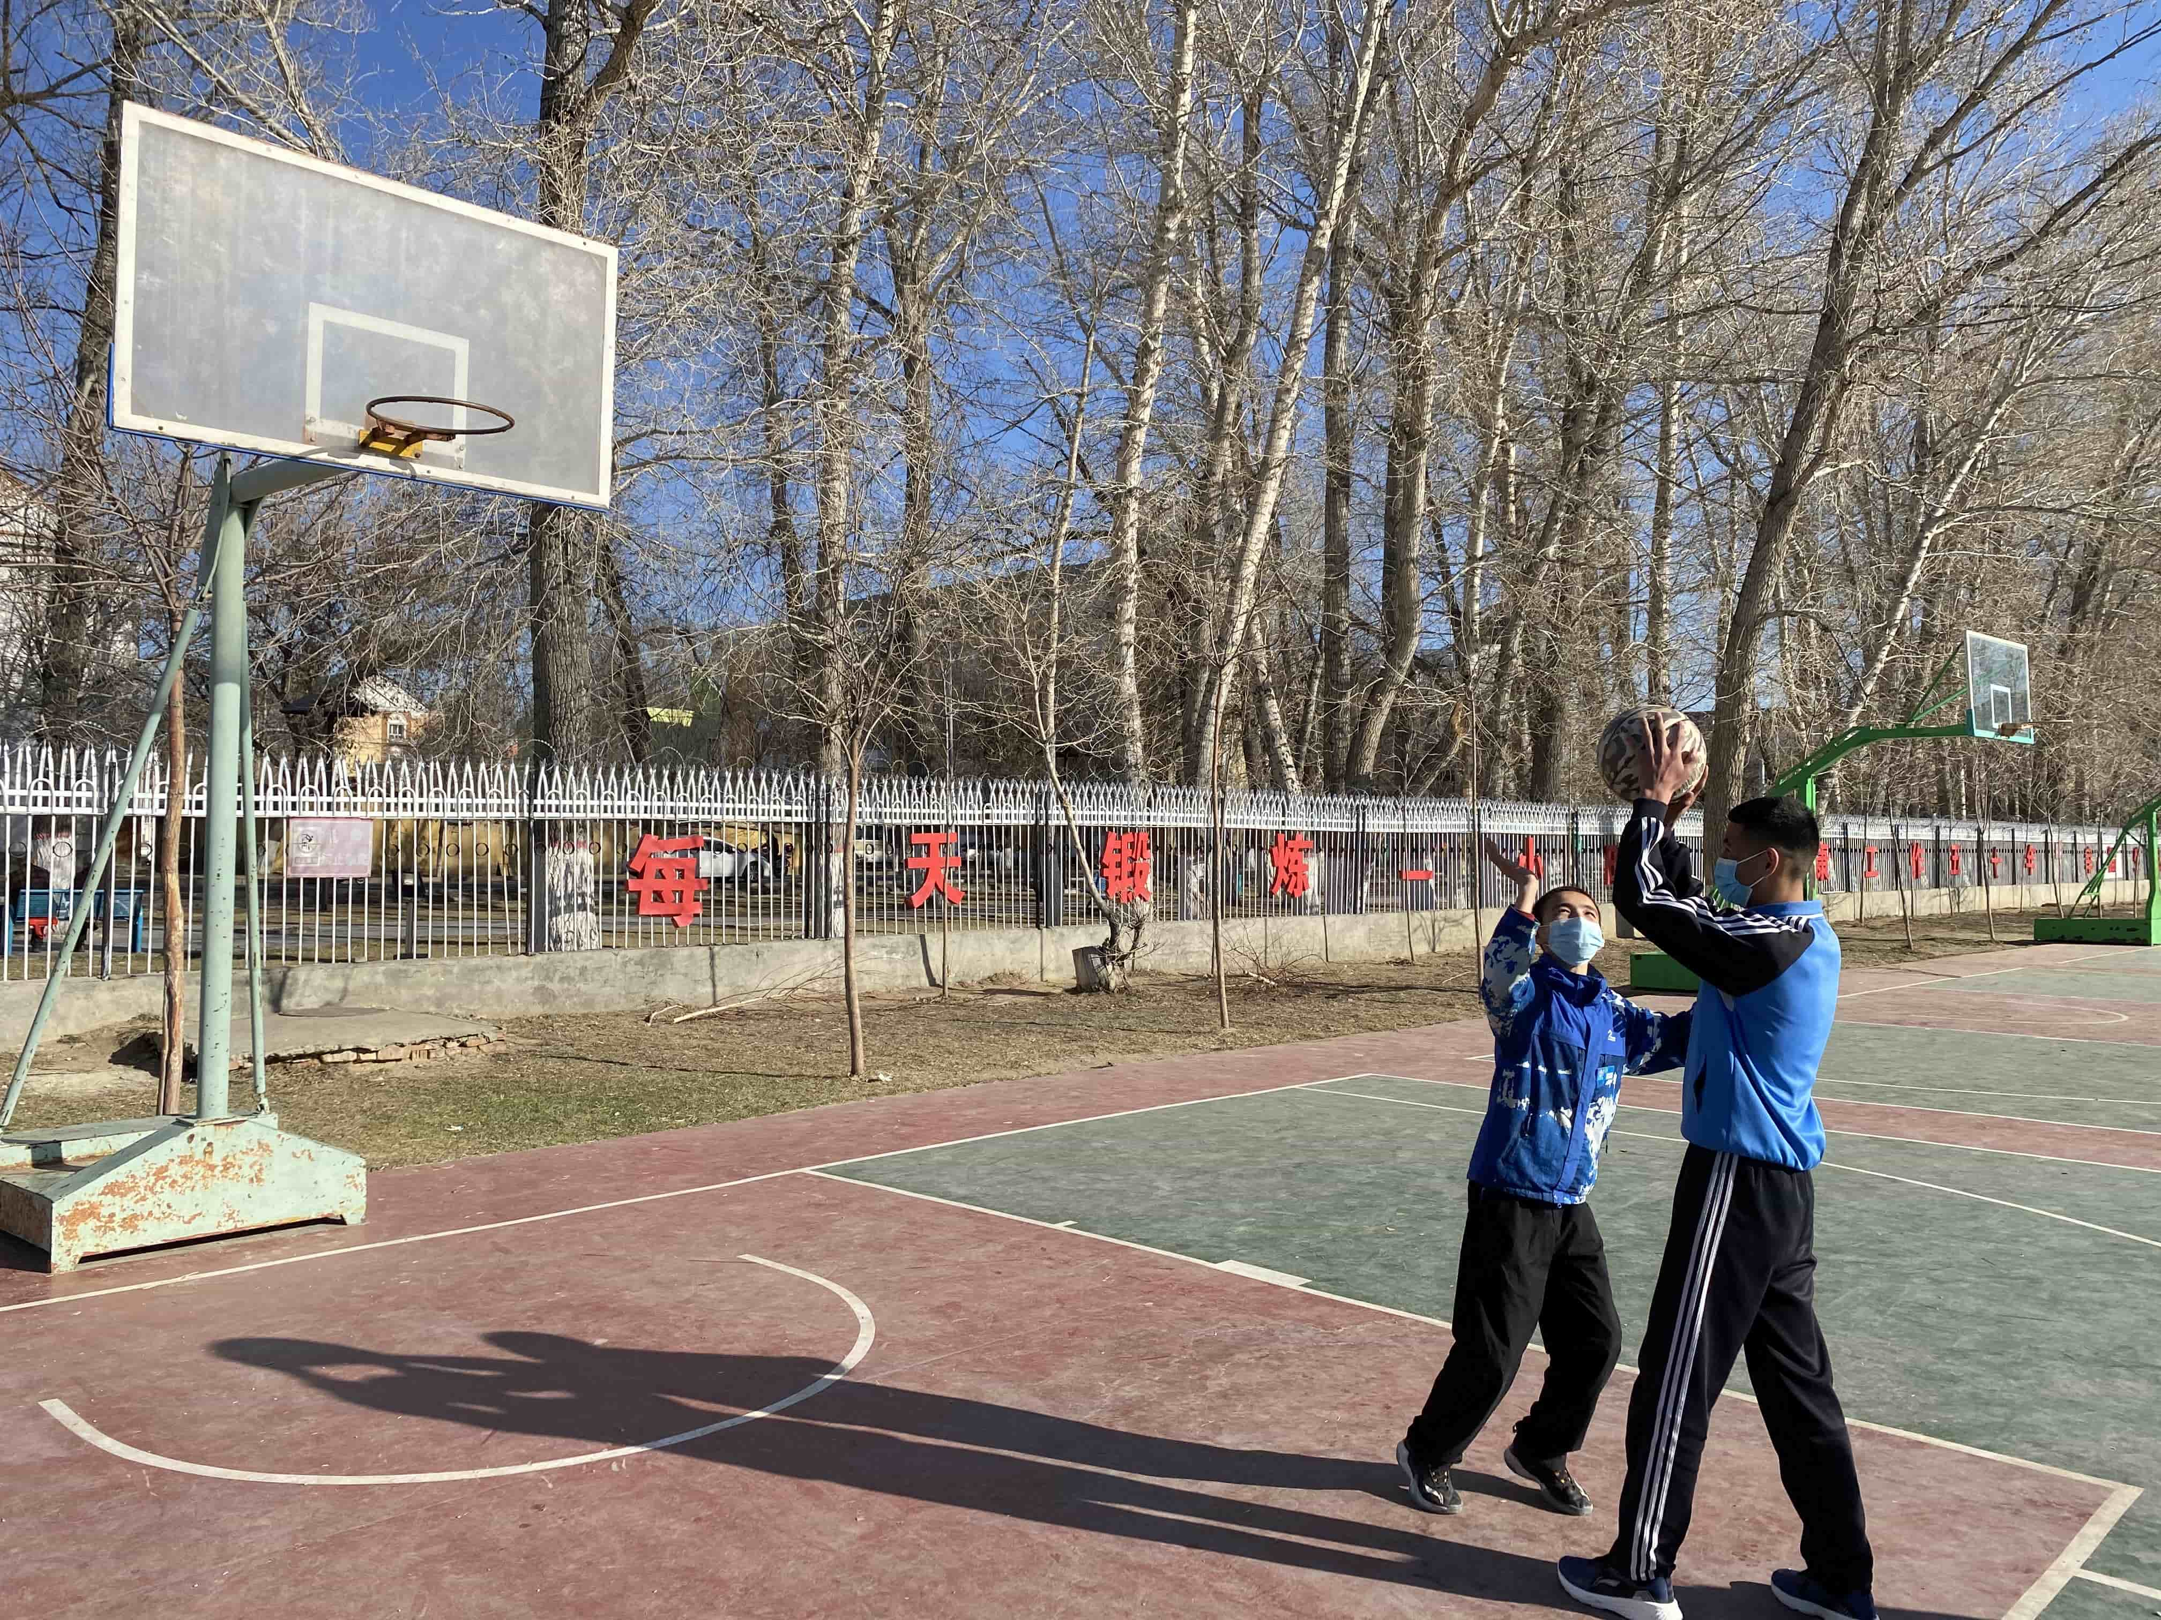
What are they doing now ?
They are playing basketball .
What were they doing when the rainstorm came?
They
were playing
basketball .
Notes:
*

Slide 11
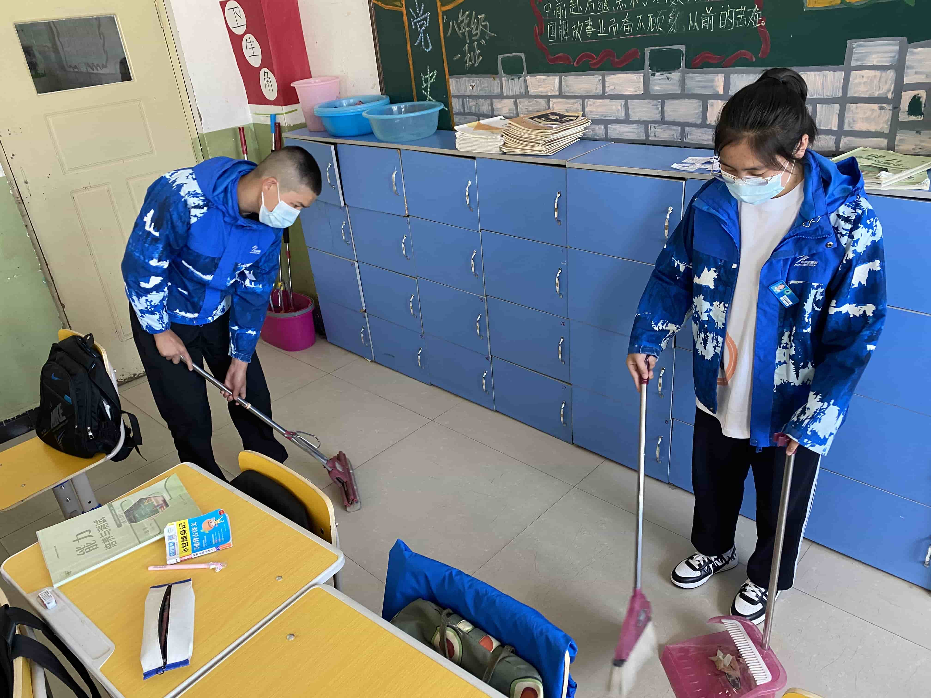
What are they doing now ?
They are cleaning the classroom .
What were they doing when the rainstorm came?
They
were cleaning the classroom .
Notes:
*

Slide 12
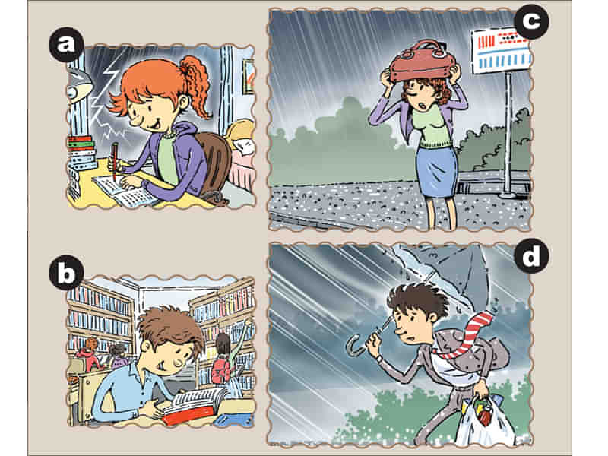

Where were the people at the time of the rainstorm? Match the statements with the people in the picture.
1a

Slide 13
Where were you at the time of the rainstorm?
1. ____ I was in the library.
2. ____ I was in my house.
3. ____ I was on the street.
4. ____ I was at the bus stop.
b
a
d
c

Slide 14
Listen to the TV report and circle the correct responses.
1b
a. doing my homework / studying
b. playing basketball / reading
c. going to work / waiting for the bus
d. walking home / shopping

Slide 15

Talk about what the people in 1a were doing at the time of the rainstorm.
1c
过去进行时
A: What was the girl doing at the time of the rainstorm?
B: She was...

Slide 16


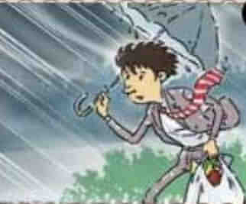
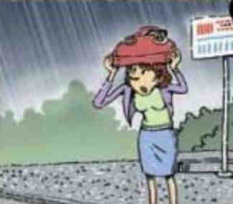
Make conversations.
A: What was he / she doing when the rainstorm came
at the time of the rainstorm?
B:She / He was ...
doing her homework
reading
waiting for a bus
walking home

Slide 17


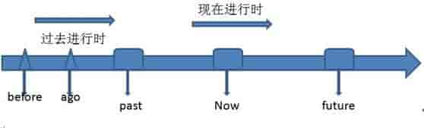
现在进行时
过去进行时
Summary
含义：表示现在某一时刻或某一时间段正在进行的动作
结构： am/is/are+动词-ing
例句：We are having an English class.
含义：表示过去某一时刻或某一时间段正在进行的动作(常和表过去的时间状语连用）
结构：was/were+动词-ing
例句：We were having an English class at this time yesterday.

Slide 18

练一练
C
1、I _____ reading at that time。
A. did B. am C. was D. can
2、What were you _____ at nine last night?
A. doing B. do C. did D. does
3、We ____ for Tom at ten last Sunday.
A. were waiting B. was waiting C. waited D．waited
A
B
Notes:
*
*

Slide 19
1. 完成大册子Unit 5第一课时
2. 背诵Unit 5 前10个单词，背接下来5组动词原形、过去式、过去分词
3. 预习Unit 5第二课时

Slide 20
Thank you！

